Slide 1

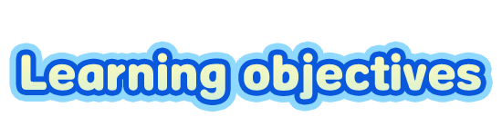

To learn some new words and useful expressions: junk, junk food, health, be good/bad for …, want sb. to do sth.
To listen for specific information in conversations
To learn to talk about healthy lifestyles and maintain a healthy lifestyle

Slide 2


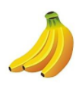

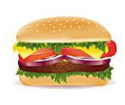
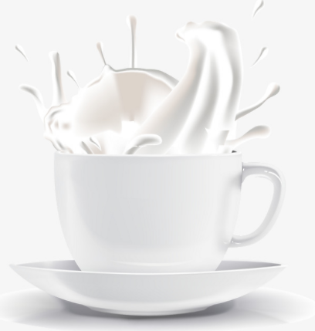
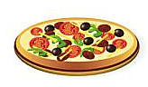

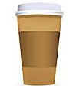

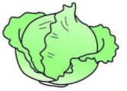
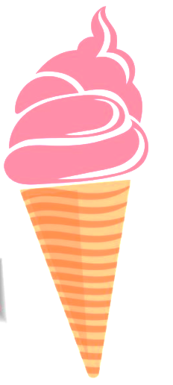
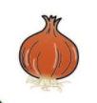
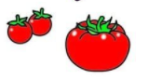
bananas
fish
hamburger
milk
food & drink
coffee
pizza
healthy or not healthy?
n. 咖啡
cabbage
bubble tea
tomatoes
onion
ice-cream

Slide 3
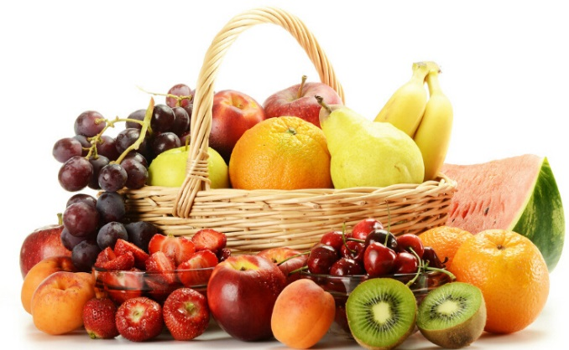
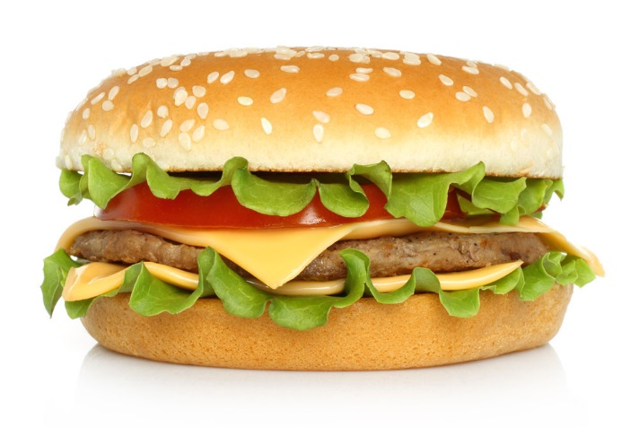
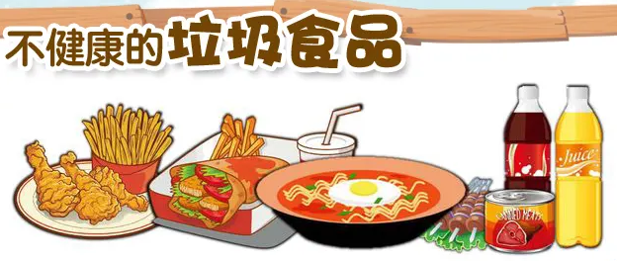
Complete the sentences and learn the new words and phrases.
_______ is good for our health.
Fruit
Hamburger
Junk food is______ for our health.
___________ is bad for our health.
bad
n. 健康; 人的身体(或精神)状态
垃圾食品

Slide 4
be good for 对……有好处
e.g. Milk is good for our health.
牛奶对我们的健康有好处。
be bad for 对……有坏处
e.g. Hot dog is bad for our health.
热狗对我们的健康有坏处。

Slide 5

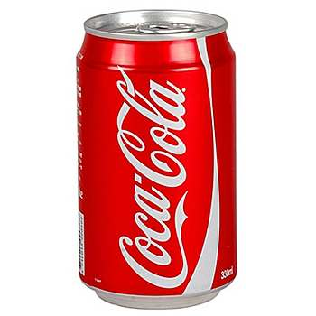
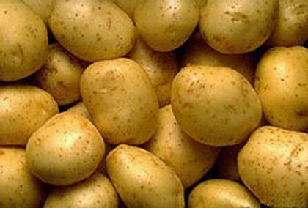
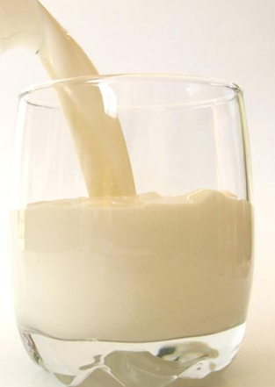
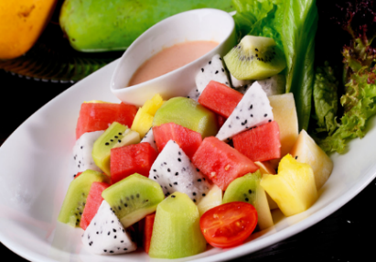
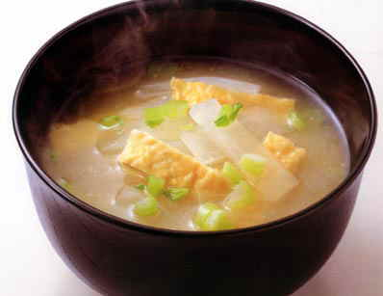
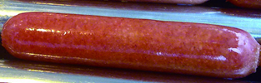
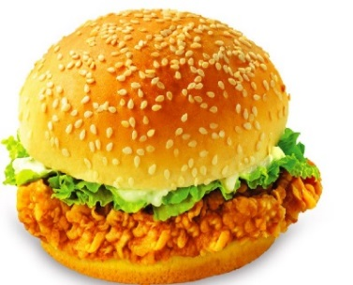
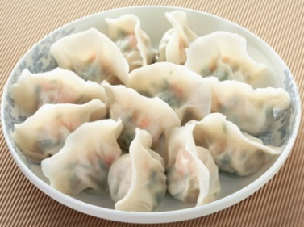
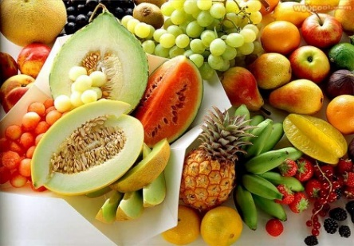
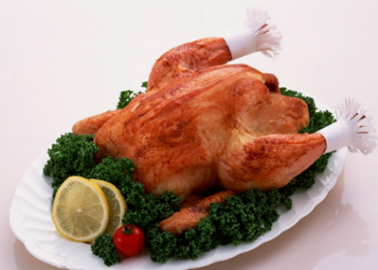
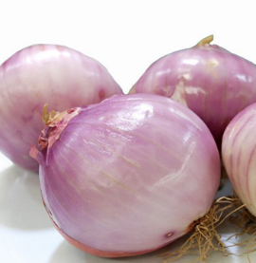
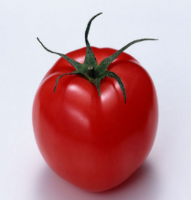
Fill in the blanks.
salad, soup, potato, milk, dumpling, fruit, chicken, onion, tomato
healthy
not healthy
cola, hot dog, hamburger

Slide 6


Discuss the questions.
What food should we always eat?
What should we often drink or eat?
What should we hardly ever or never eat?
What do you usually eat or drink?

Slide 7

want sb. to do sth. 想让某人做某事
e.g. Jim wants you to come here at 3 o’clock.
【链接】
want后面可接名词(短语)、代词或动词不定式(短语)。
e.g. Tina wants a black schoolbag.
I want to buy a new bike.

Slide 8
【语境应用】将下列句子翻译成英语。
1) 我弟弟想让我和他一起去看电影。
2) 有人想见你。
3) 她想要一些咖啡。
My brother wants me to go to the movies with him.
Someone wants to meet / see you.
She wants some coffee.

Slide 9

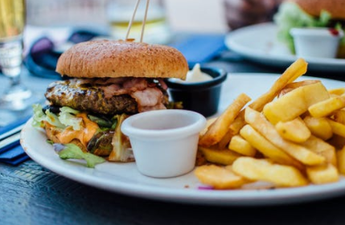
A: How often do you eat junk food?
B: I eat it once a week.
A: Do you like it?
B: Yes. But my mother doesn’t let me eat it. She says it’s bad for my health.

Slide 10
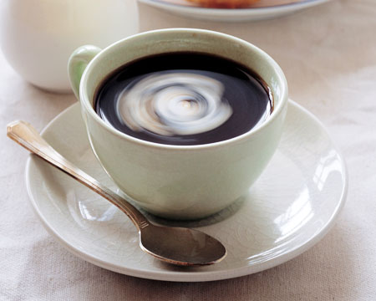
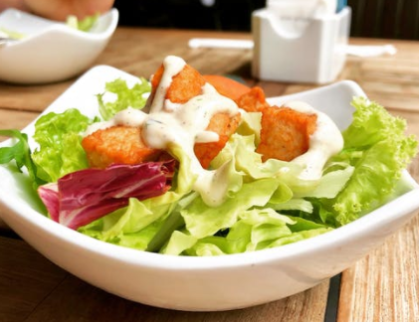
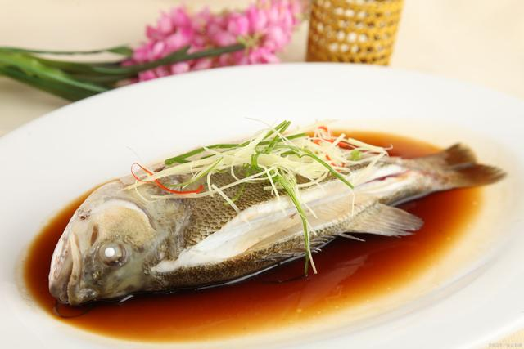
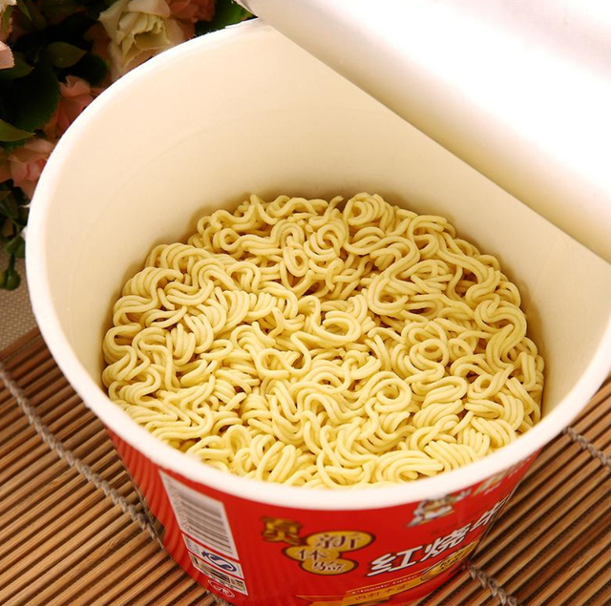
A: How often do you drink/eat…?
B: I drink/eat ...
A: Do you like …?
B: Yes. / No. …

Slide 11

Unit 2

Slide 12
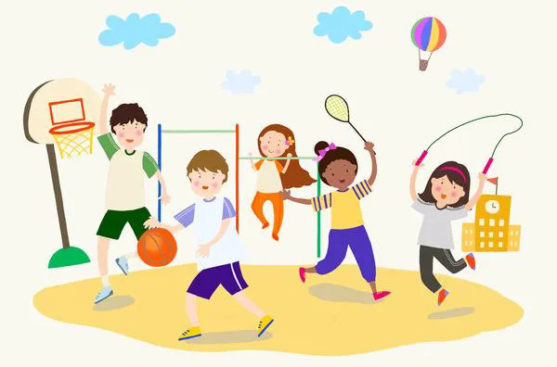
Unit 2
How often do you exercise?

Slide 13
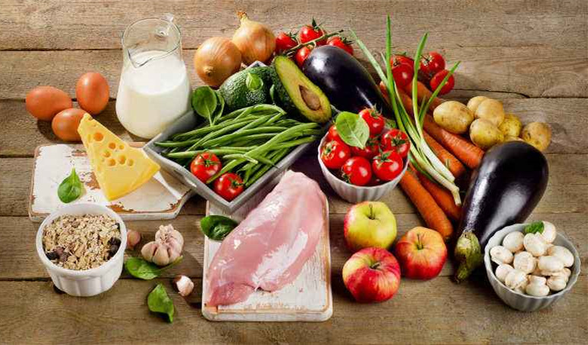
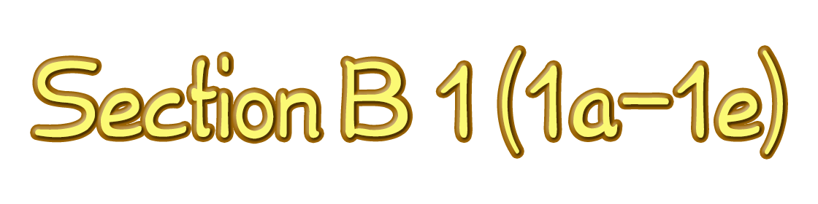

Slide 14
Review
在周末
一周两 / 三次
摇摆舞
怎么会呢？
去看电影
几乎从不
帮忙做家务
on weekends
twice / three times a week
swing dance
How come?
go to the movies
hardly ever
help with housework

Slide 15
Review
8.去购物
9.使用互联网
10.阅读英文书籍
11.最喜欢的节目
12.上钢琴课
go shopping
use the Internet
read English books
favorite program
have piano lessons

Slide 16

Exercise
Complete the questions with do or does.
1. How often _____ he play soccer?
2. _____ you drink milk?
3. How often _____ they stay up late?
4. _____ Sue eat a healthy breakfast?
5. How often _____ you eat apples?
6. _____ your parents play sports?
does
Do
do
Does
do
Do
Note: 主语为第三人称单数时，助动词用does；
主语为其他人称及第三人称复数时,用do。

Slide 17
answers
Then match the questions
and answers.
a. Yes. She usually does.
b. Hardly ever. I don’t like them.
c. He plays at least twice a week.
d. No, they don’t. They’re too busy.
e. Never. They always go to bed early.
f. Yes, I do. Every day.
questions
1. How often does he play soccer?
2. Do you drink milk?
3. How often do they stay up late?
4. Does Sue eat a healthy breakfast?
5. How often do you eat apples?
6. Do your parents play sports?
c
f
e
a
b
d

Slide 18
1. What is it?
It’s milk.
2. How often do you drink...?
I (频率副词) drink milk (频率副词词组).
3. Is it good for your health?
Yes, it is.
Does he/she have a good eating habit?

Slide 19
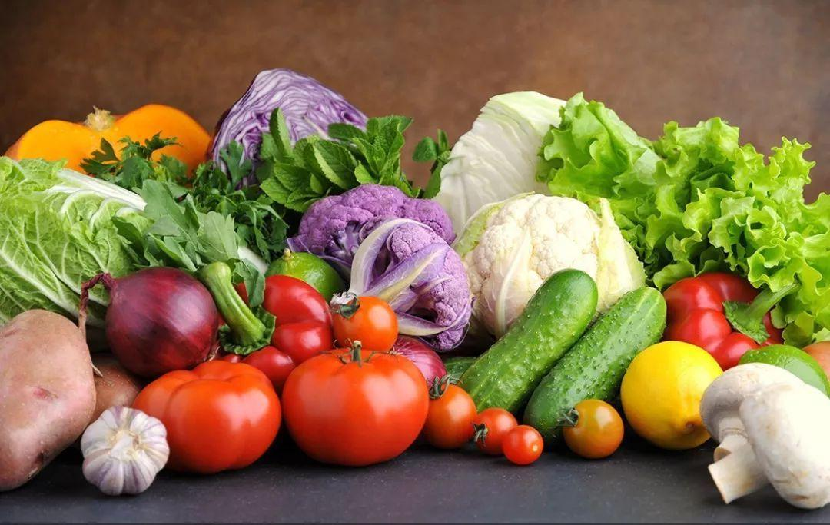
1. What are they?
They’re vegetables.
2. How often do you eat...?
I (频率副词) eat vegetables (频率副词词组).
3. Is it good for your health?
Yes, it is.
Does he/she have a bad eating habit?

Slide 20
1. What is it?
It’s fruit.
2. How often do you eat...?
I (频率副词) eat fruit (频率副词词组).
3. Is it healthy for you?
Yes, it is.
Does he/she have a good eating habit?

Slide 21
1. What is it?
It’s junk food.
2. How often do you have...?
I (频率副词) have junk food (频率副词词组).
3. If you have so much, is it good for your health?
No, it isn’t.
Does he/she have a bad eating habit?

Slide 22
1. What is it?
It’s coffee.
2. How often do you have...?
I (频率副词) have coffee (频率副词词组).
3. If you have so much, is it bad for your health?
Yes, it is.
Does he/she have a good eating habit?

Slide 23
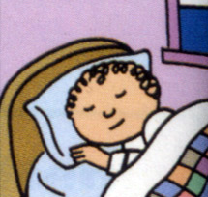
1. What does he do?
He sleeps.
2. How many hours do you... every day?
I sleep for about ... hours.
3. Is it bad for your health?
Yes, it is./ No, it isn’t.
Does he/she have a bad daily habit?

Slide 24

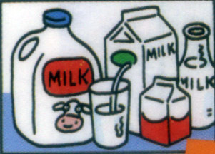
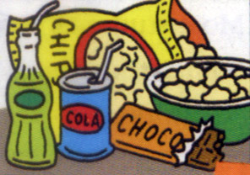
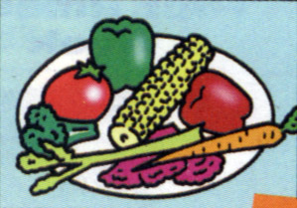
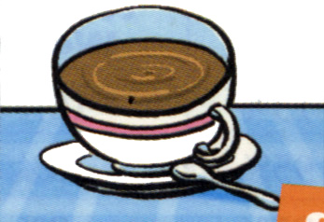
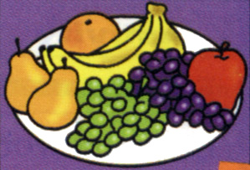
Match the words with the pictures.
1. __ junk food 3. __ fruit 5. __ sleep
2. __ milk 4. __ vegetables 6. __ coffee
b
e
f
a
c
d
b
c
a
e
f
d

Slide 25

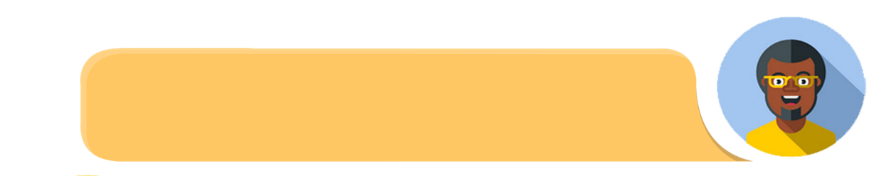
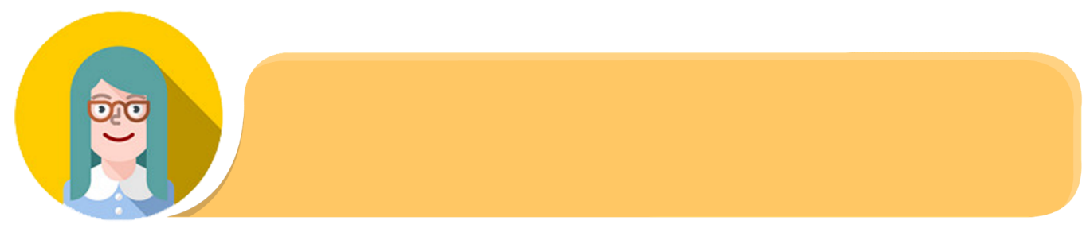
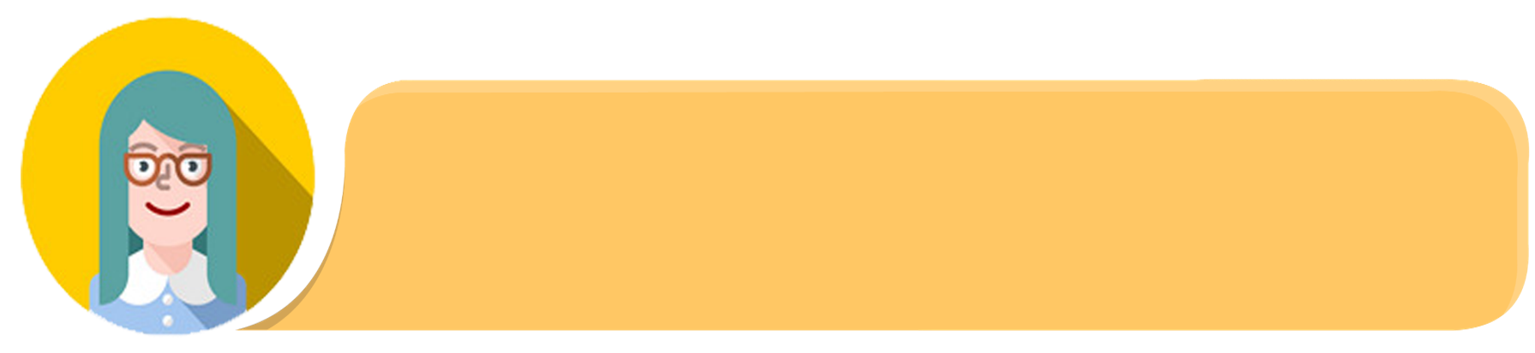
Pair-work
Ask and answer questions. Use the words from 1a.
How often do you drink milk, Liu Fang?
I drink milk every day.
Do you like it?/
Is it good/bad for your heath?
No. But my mother wants me to drink it. She says it’s good for my health.

Slide 26

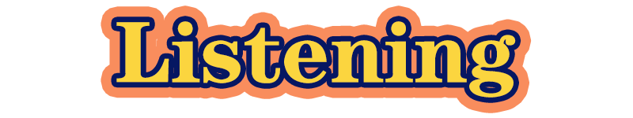




Listen to an interview(采访) about two people’s daily habits. Circle your answer to each question.
Does Tina have good habits?
Yes. No. I don’t know.
Does Bill have good habits?
Yes. No. I don’t know.

Slide 27

Listen again. Fill in the blanks in the survey(调查).
Questions Tina(girl) Bill(boy)
1. How often do you exercise? __________ __________ 2. How often do you eat fruit? __________ __________ 3. How many hours do you sleep every night? __________ __________ 4. How often do you drink milk? __________ __________ 5. How often do you eat junk food? __________ _________ 6. How often do you drink coffee? __________ __________
every day
hardly ever
every day
never
nine
nine
every day
never
2 or 3 times a week
3 or 4 times a week
never
4 times a day

Slide 28
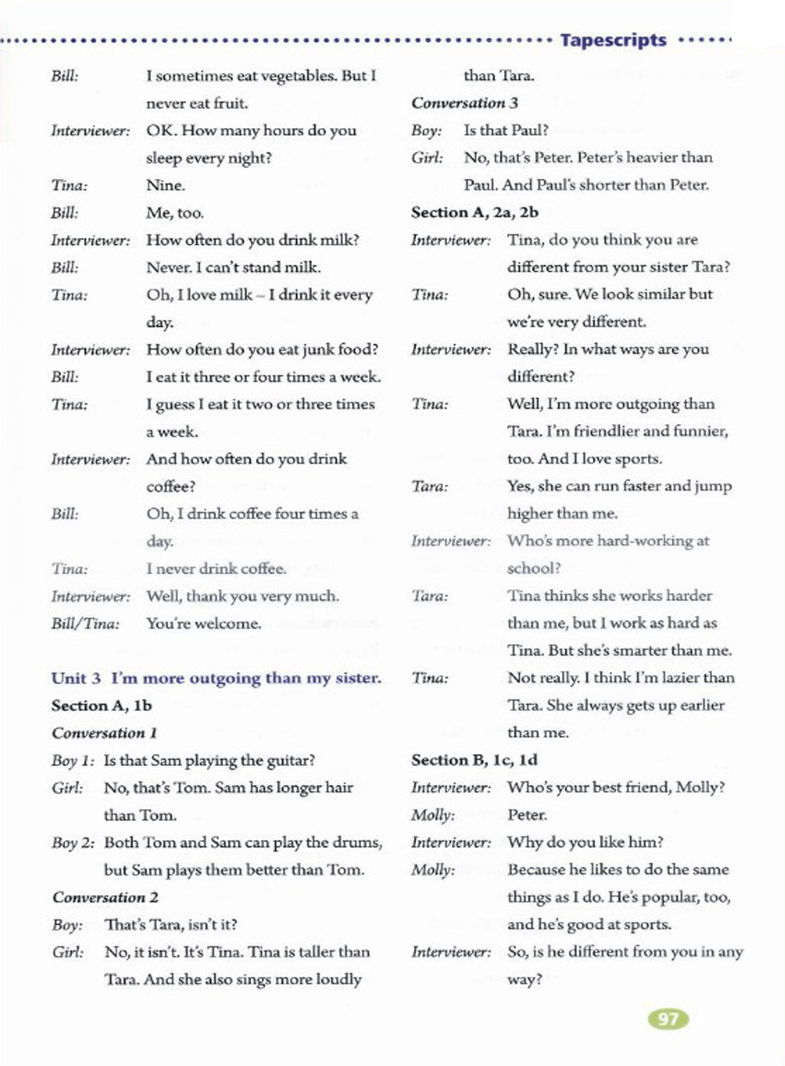

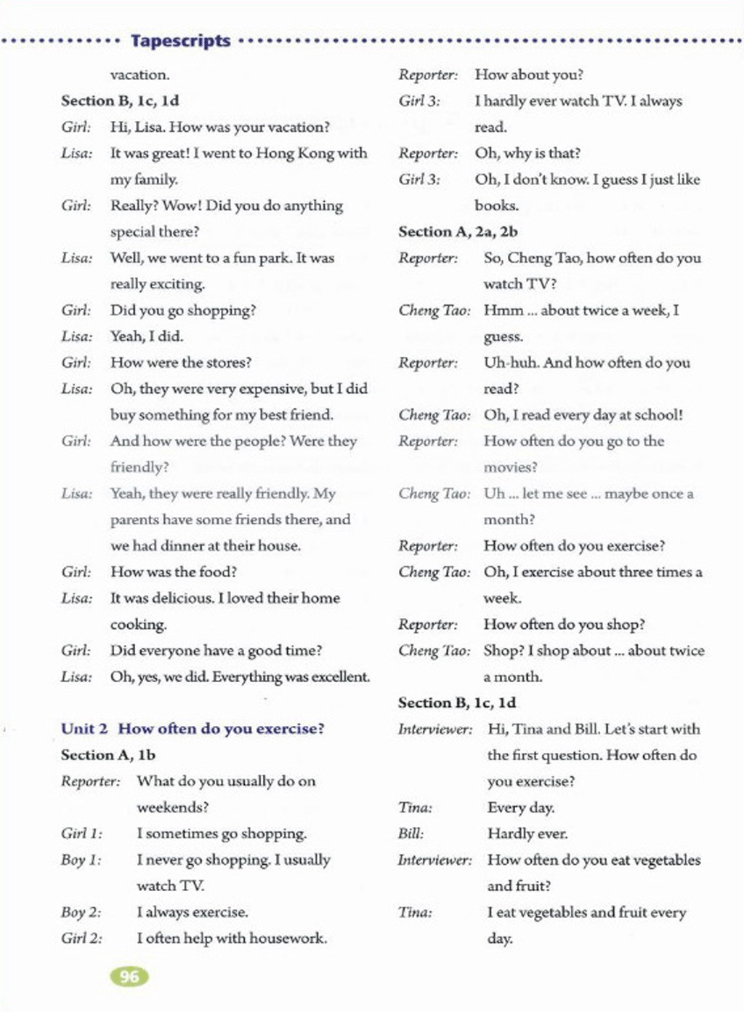

Slide 29
Tina’s Good/Healthy Habits
I think Tina has good habits, because she exercises and eats fruit every day. She sleeps for nine hours every night. And she likes milk very much,so she drinks milk every day. She eats junk food 2 or 3 times a week, but she never drinks coffee. So she is very healthy and her lifestyle(生活方式) is good.

Slide 30


Slide 31


喝牛奶
垃圾食品
对某人的健康有好处
有好 / 坏习惯
想让某人做某事
drink milk
junk food
be good for one's health
have good / bad habits
want sb. to do sth.

Slide 32


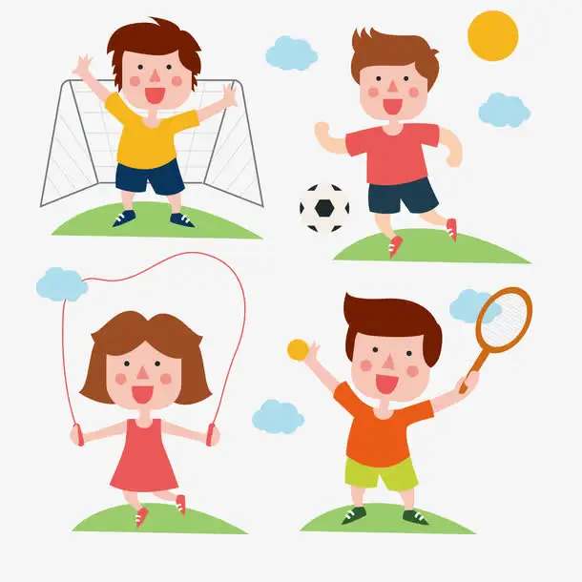
Student A is the reporter. Student B is Tina or Bill. Ask and answer questions. Then change roles.
A: How often do you exercise?
B: I exercise every day.
A: And how often do you …?

Slide 33
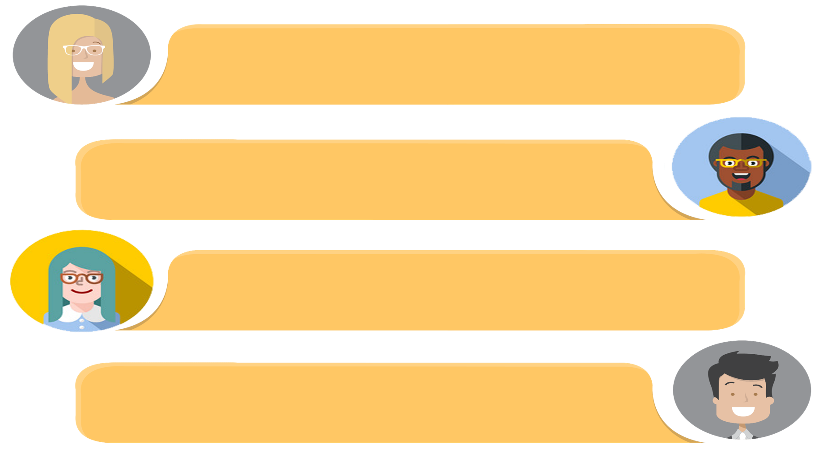

How often do you exercise?
Guess.
I don’t know … Maybe twice a week?
No. Three times a week. Are we finished?
No, not yet. I have another question. How often do you eat vegetables?
Guess.

Slide 34


I. 根据语境及所给首字母提示，补全所缺单词。
1. —Would you like some c________, sir?
—No, thanks. For drinks, I only like tea.
2. —She is 80 and is still in very good h________.
—Yeah. She exercises every day.
coffee
health

Slide 35
II. 根据括号内的要求完成下列各题。
1. We often eat fruit. (改为一般疑问句)
________ ________ often ________ fruit?
2. Sometimes Emma drinks milk. (改为否定句)
Sometimes Emma ________ ________ milk.
Do you eat
doesn’t drink
3. Tom eats dumplings once a week. (对划线部分提问)
________ ________ ________ Tom ________ dumplings?
4. The old man is in good health. (改为同义句)
The old man ________ ________.
How often does eat
is healthy

Slide 36


1. Make a conversation according to 1d.
2. Preview the article in 2b on page 13.

